Slide 1
BMD ENG 301 Quantitative Systems Physiology (Nervous System)
Muscle
2022_v2
Prof Malcolm MacIver

Slide 2
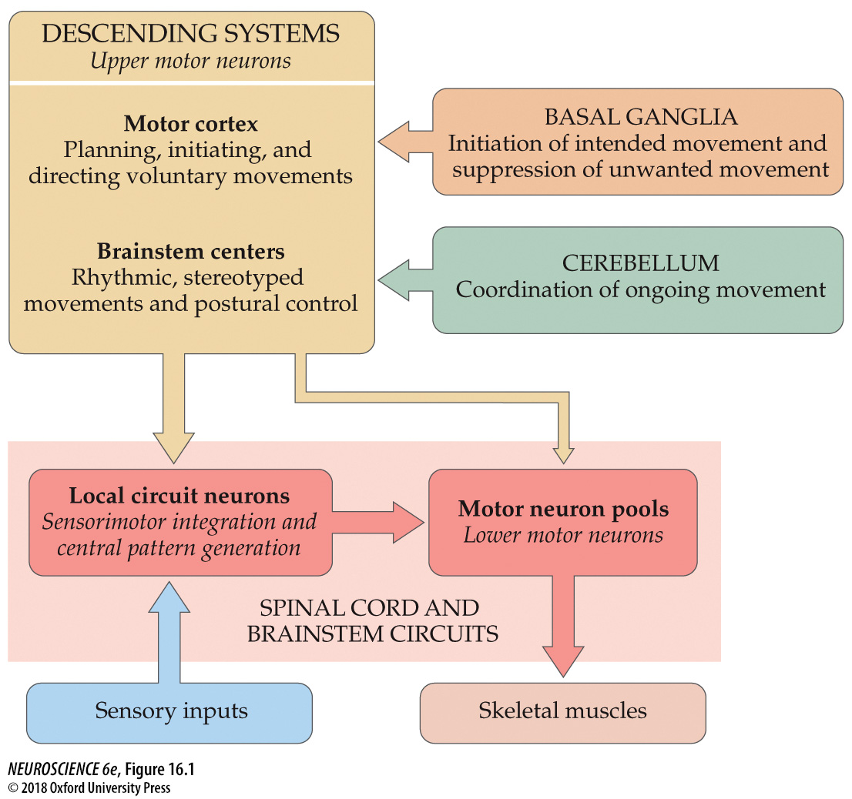

Slide 3
Agenda
Muscle structure
Neuromuscular junction
Excitation-contraction coupling
Sliding Filament Theory
Properties of skeletal muscle
Muscle signals and acquisition

Slide 4
Muscle Structure and the Neuromuscular Junction
Contractility: Muscles are the ONLY tissue capable of actively generating tension (force) when stimulated

Slide 5
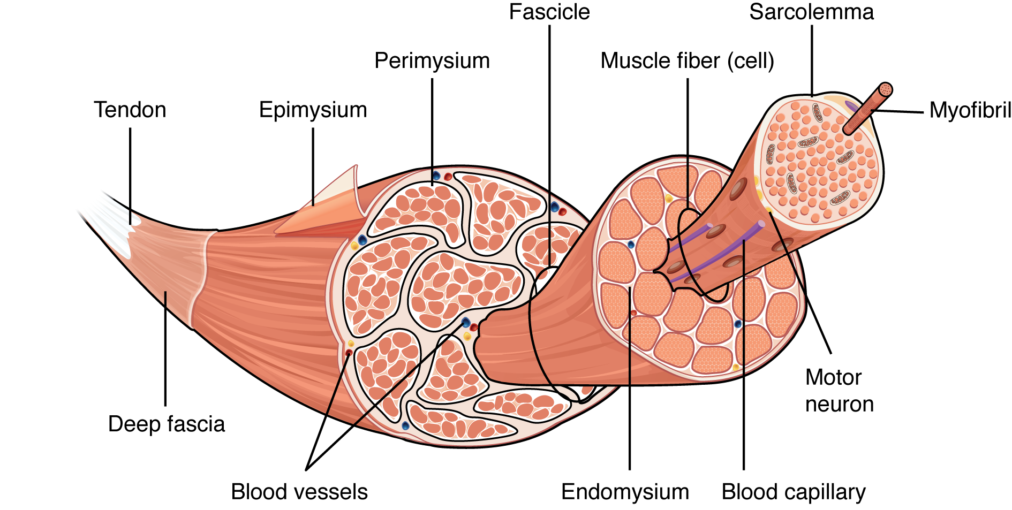
Muscle Structure and the Neuromuscular Junction

Slide 6
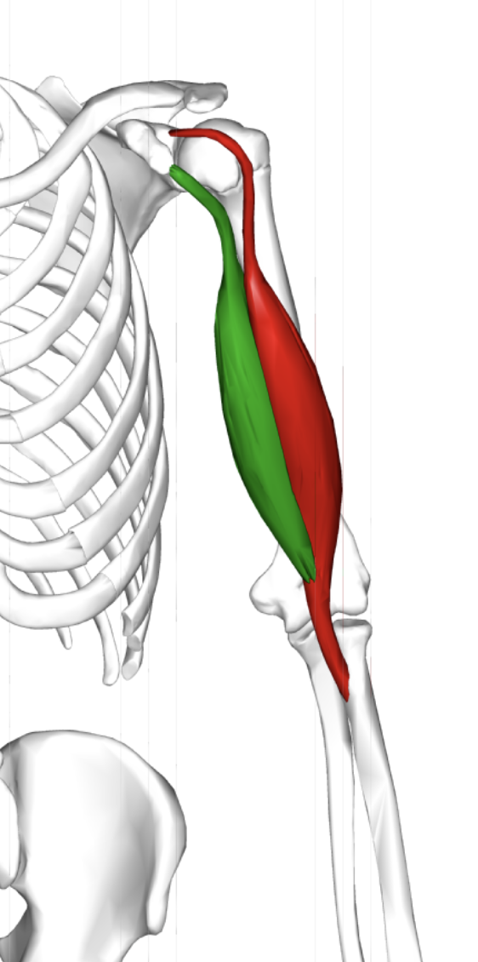
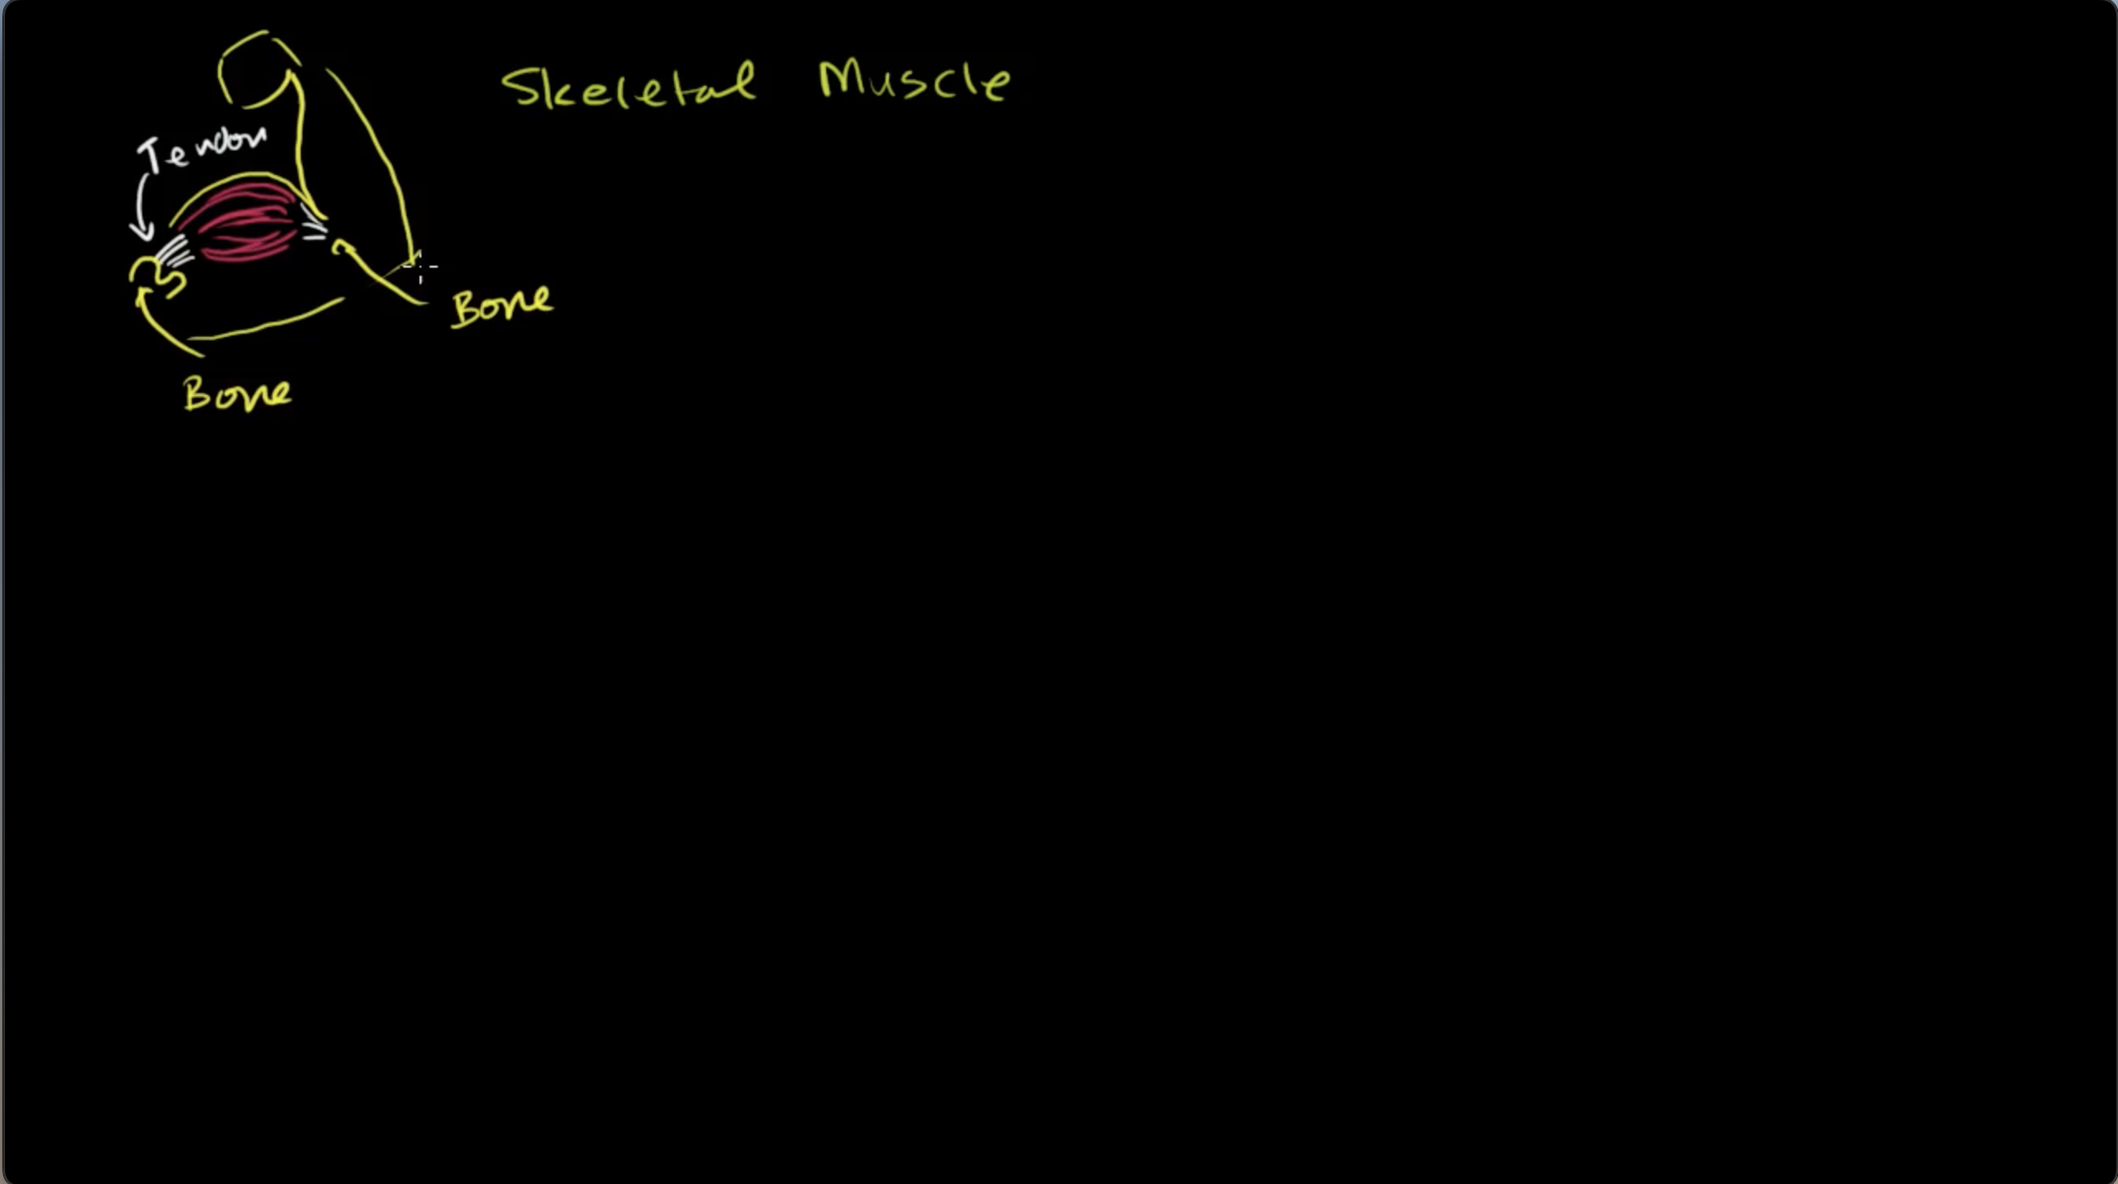
From: https://youtu.be/uY2ZOsCnXIA

Slide 7
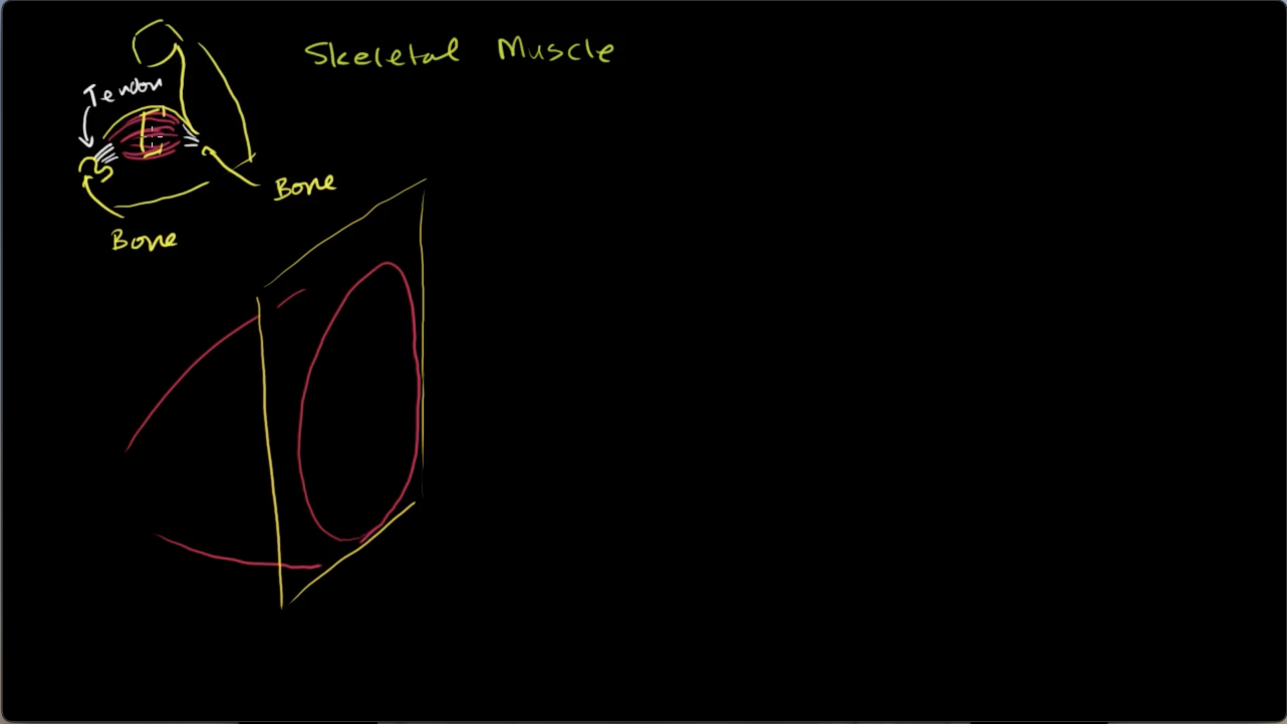

Slide 8
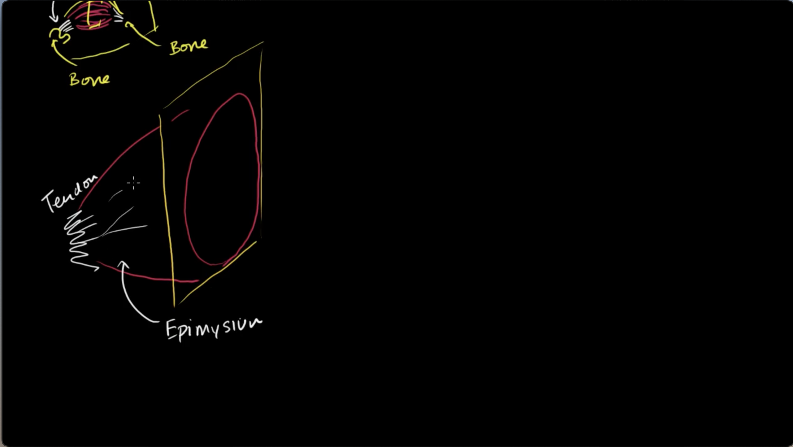

Slide 9
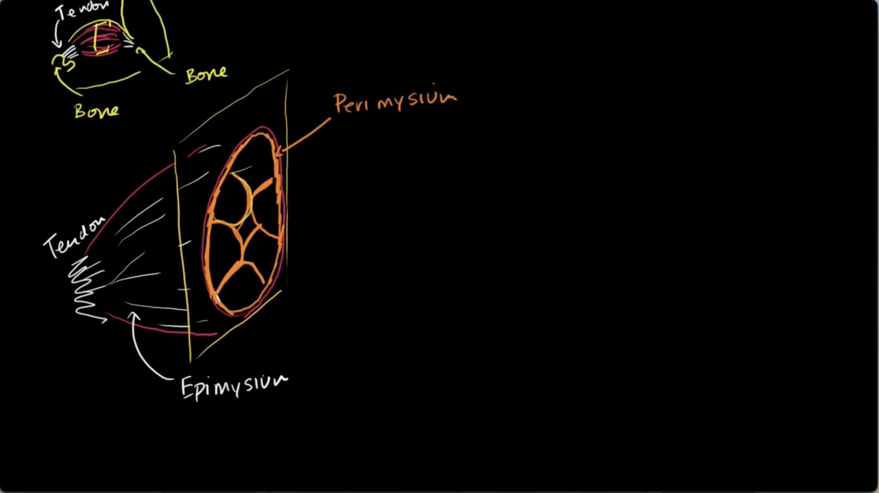

Slide 10
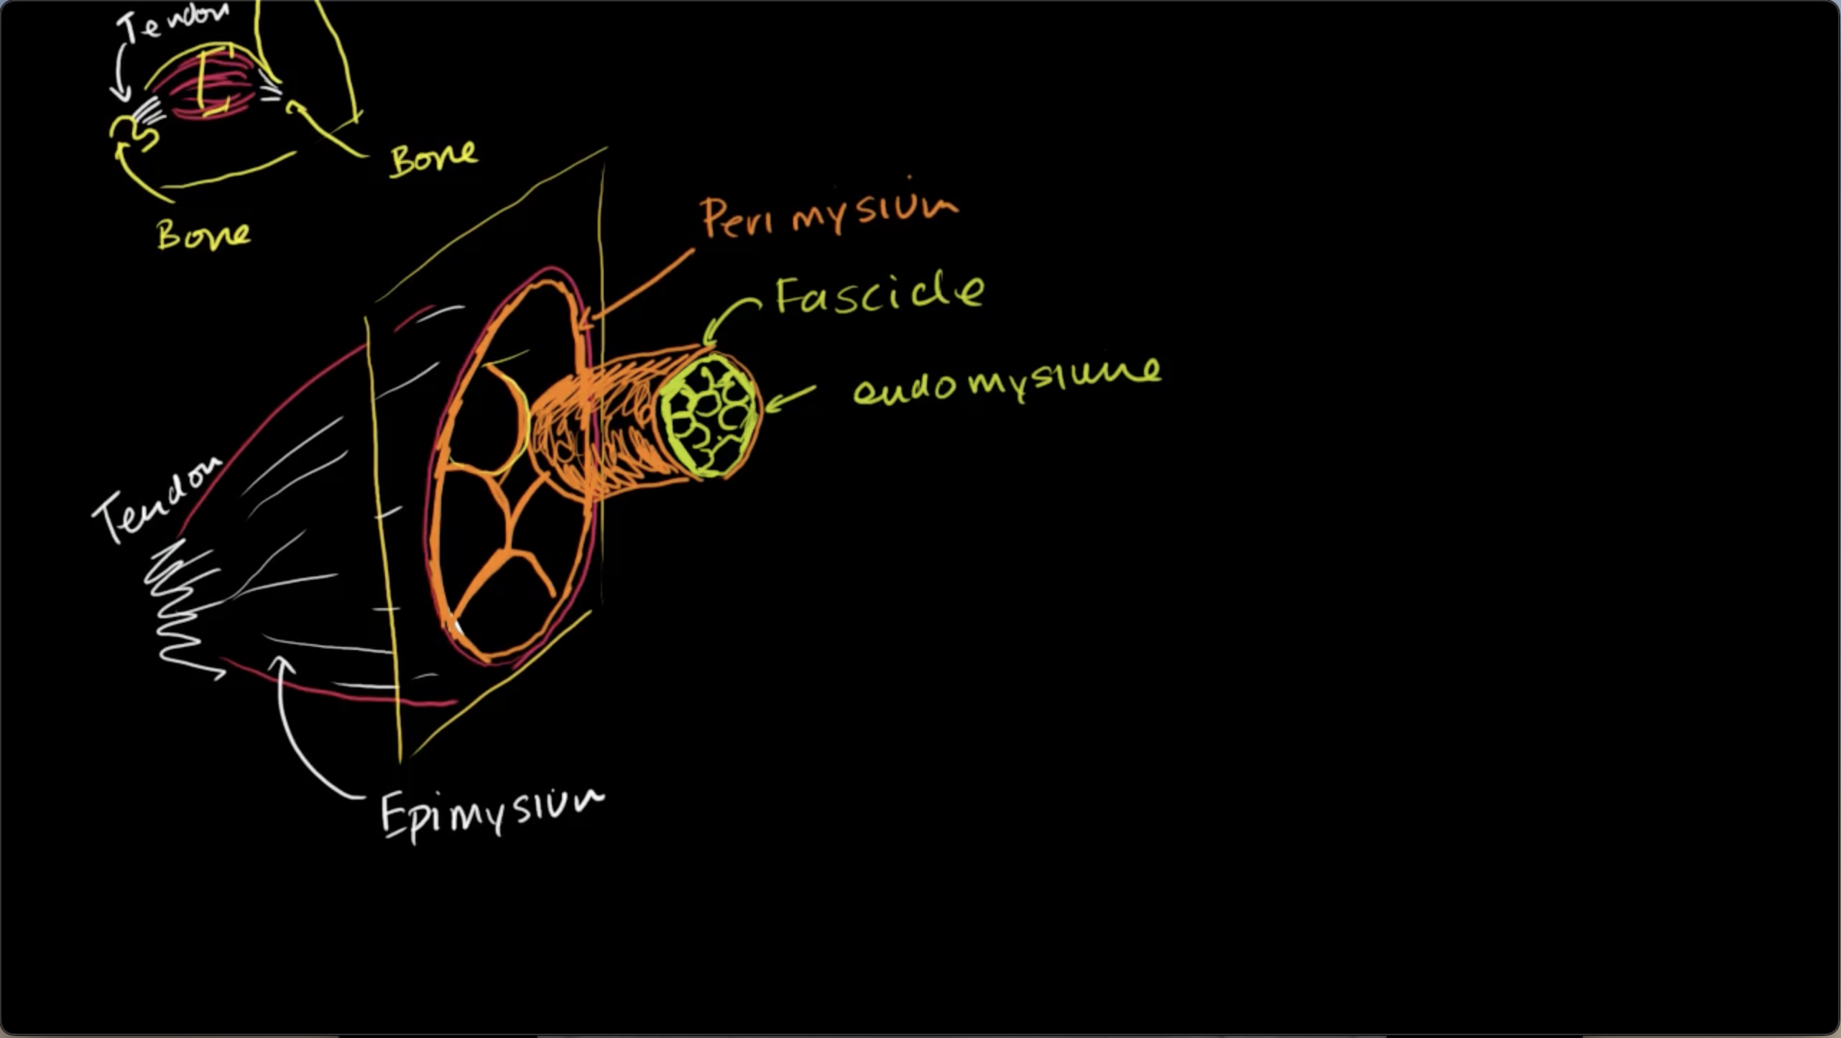

Slide 11
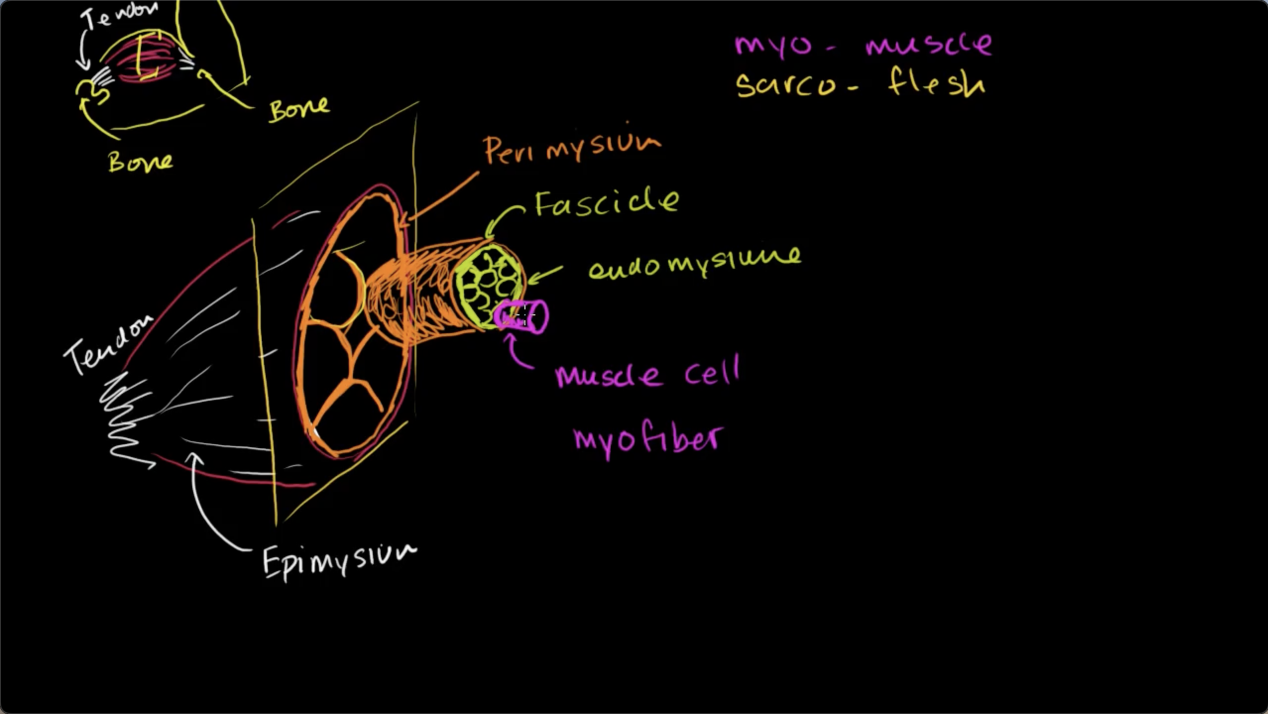

Slide 12
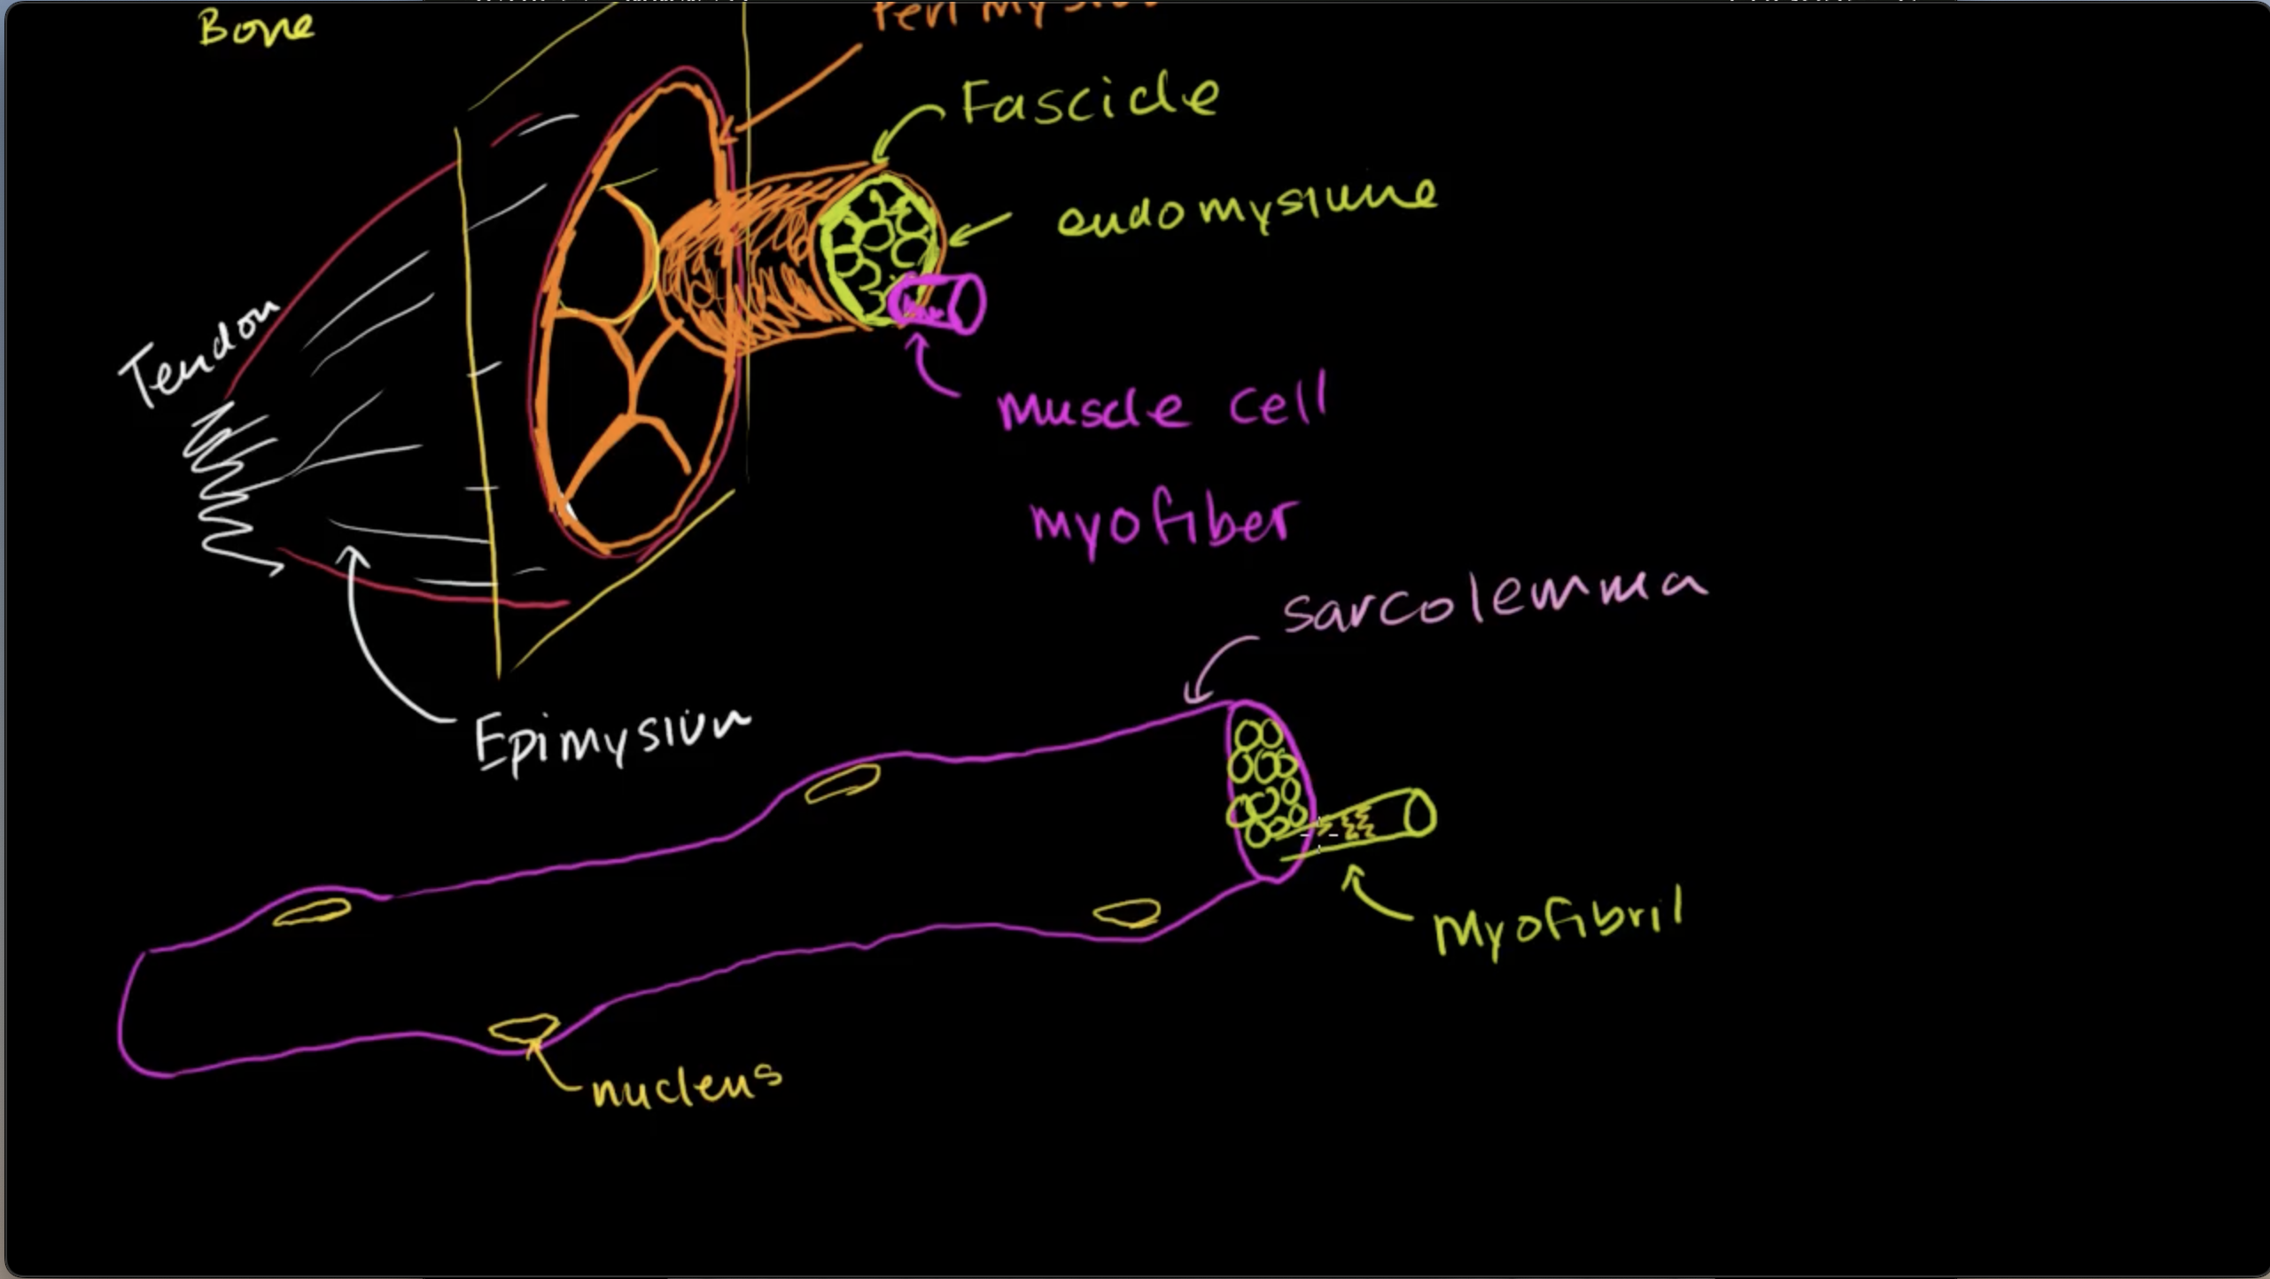

Slide 13
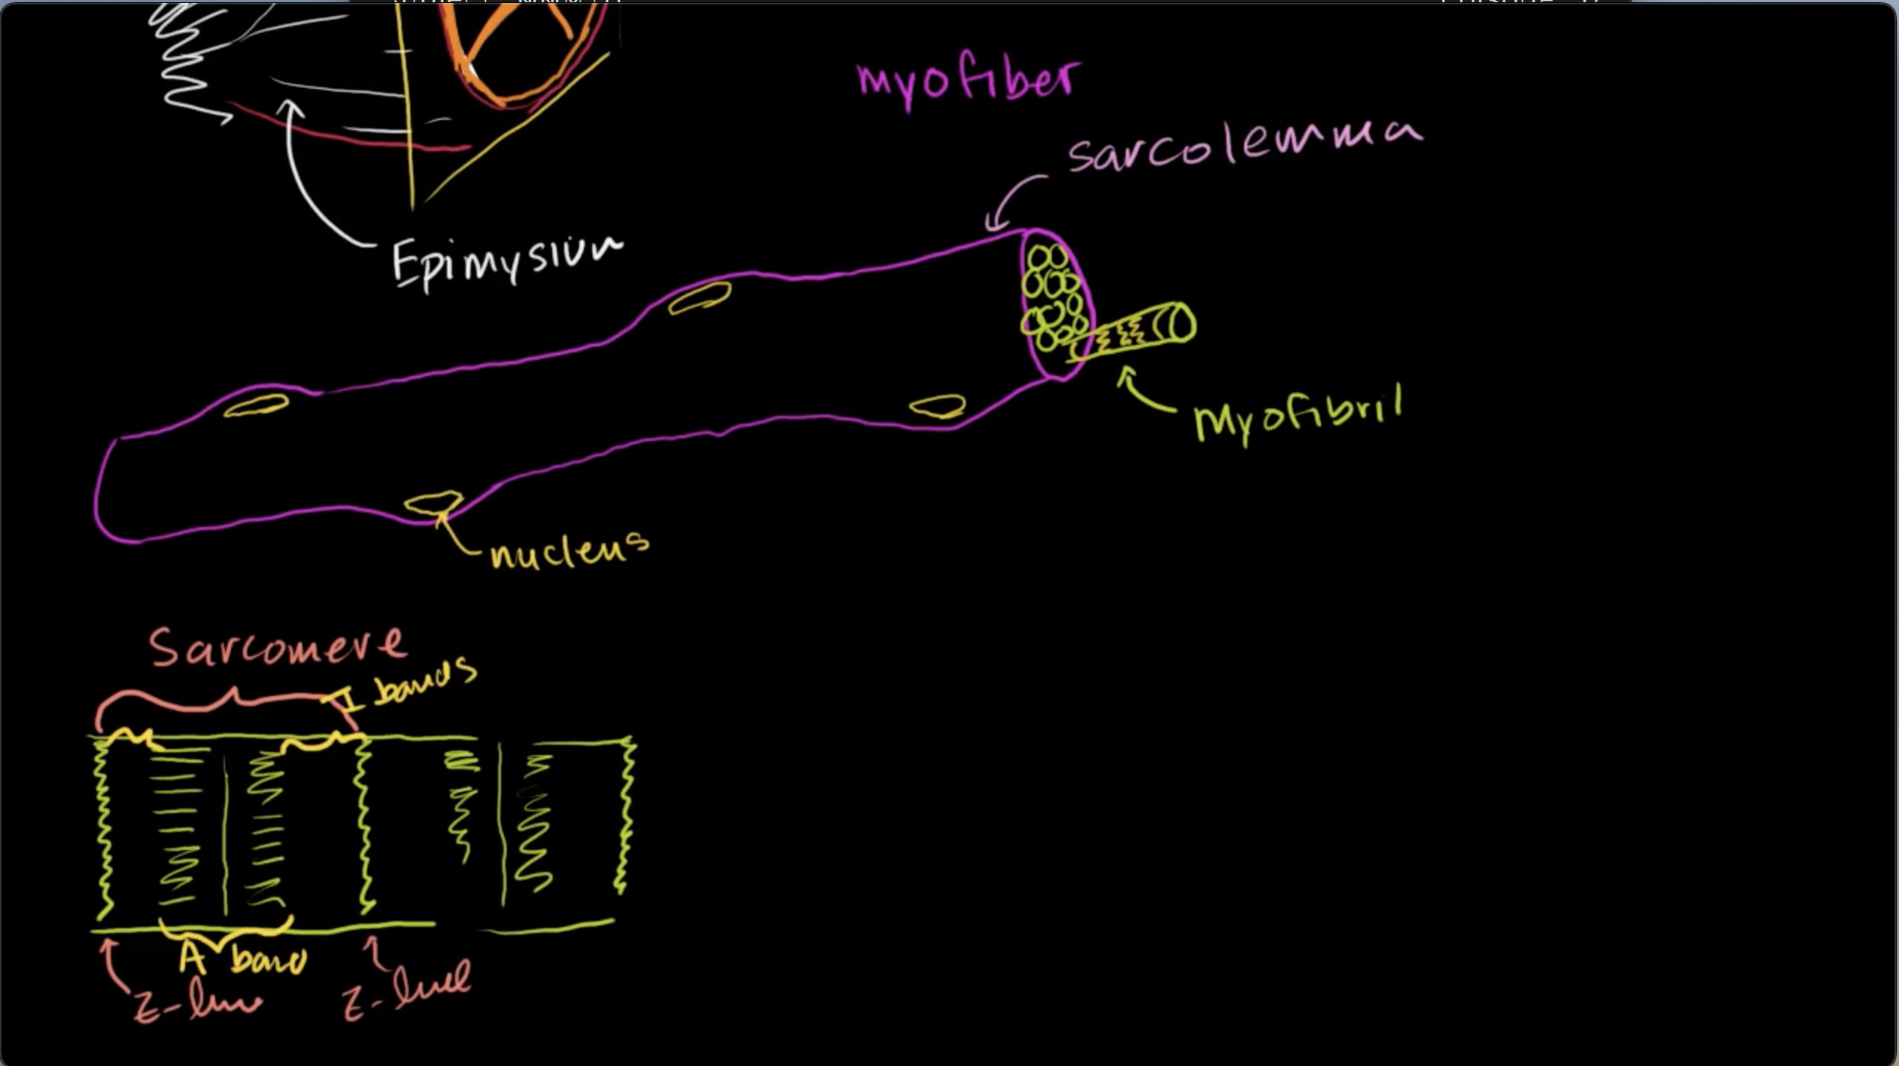

Slide 14
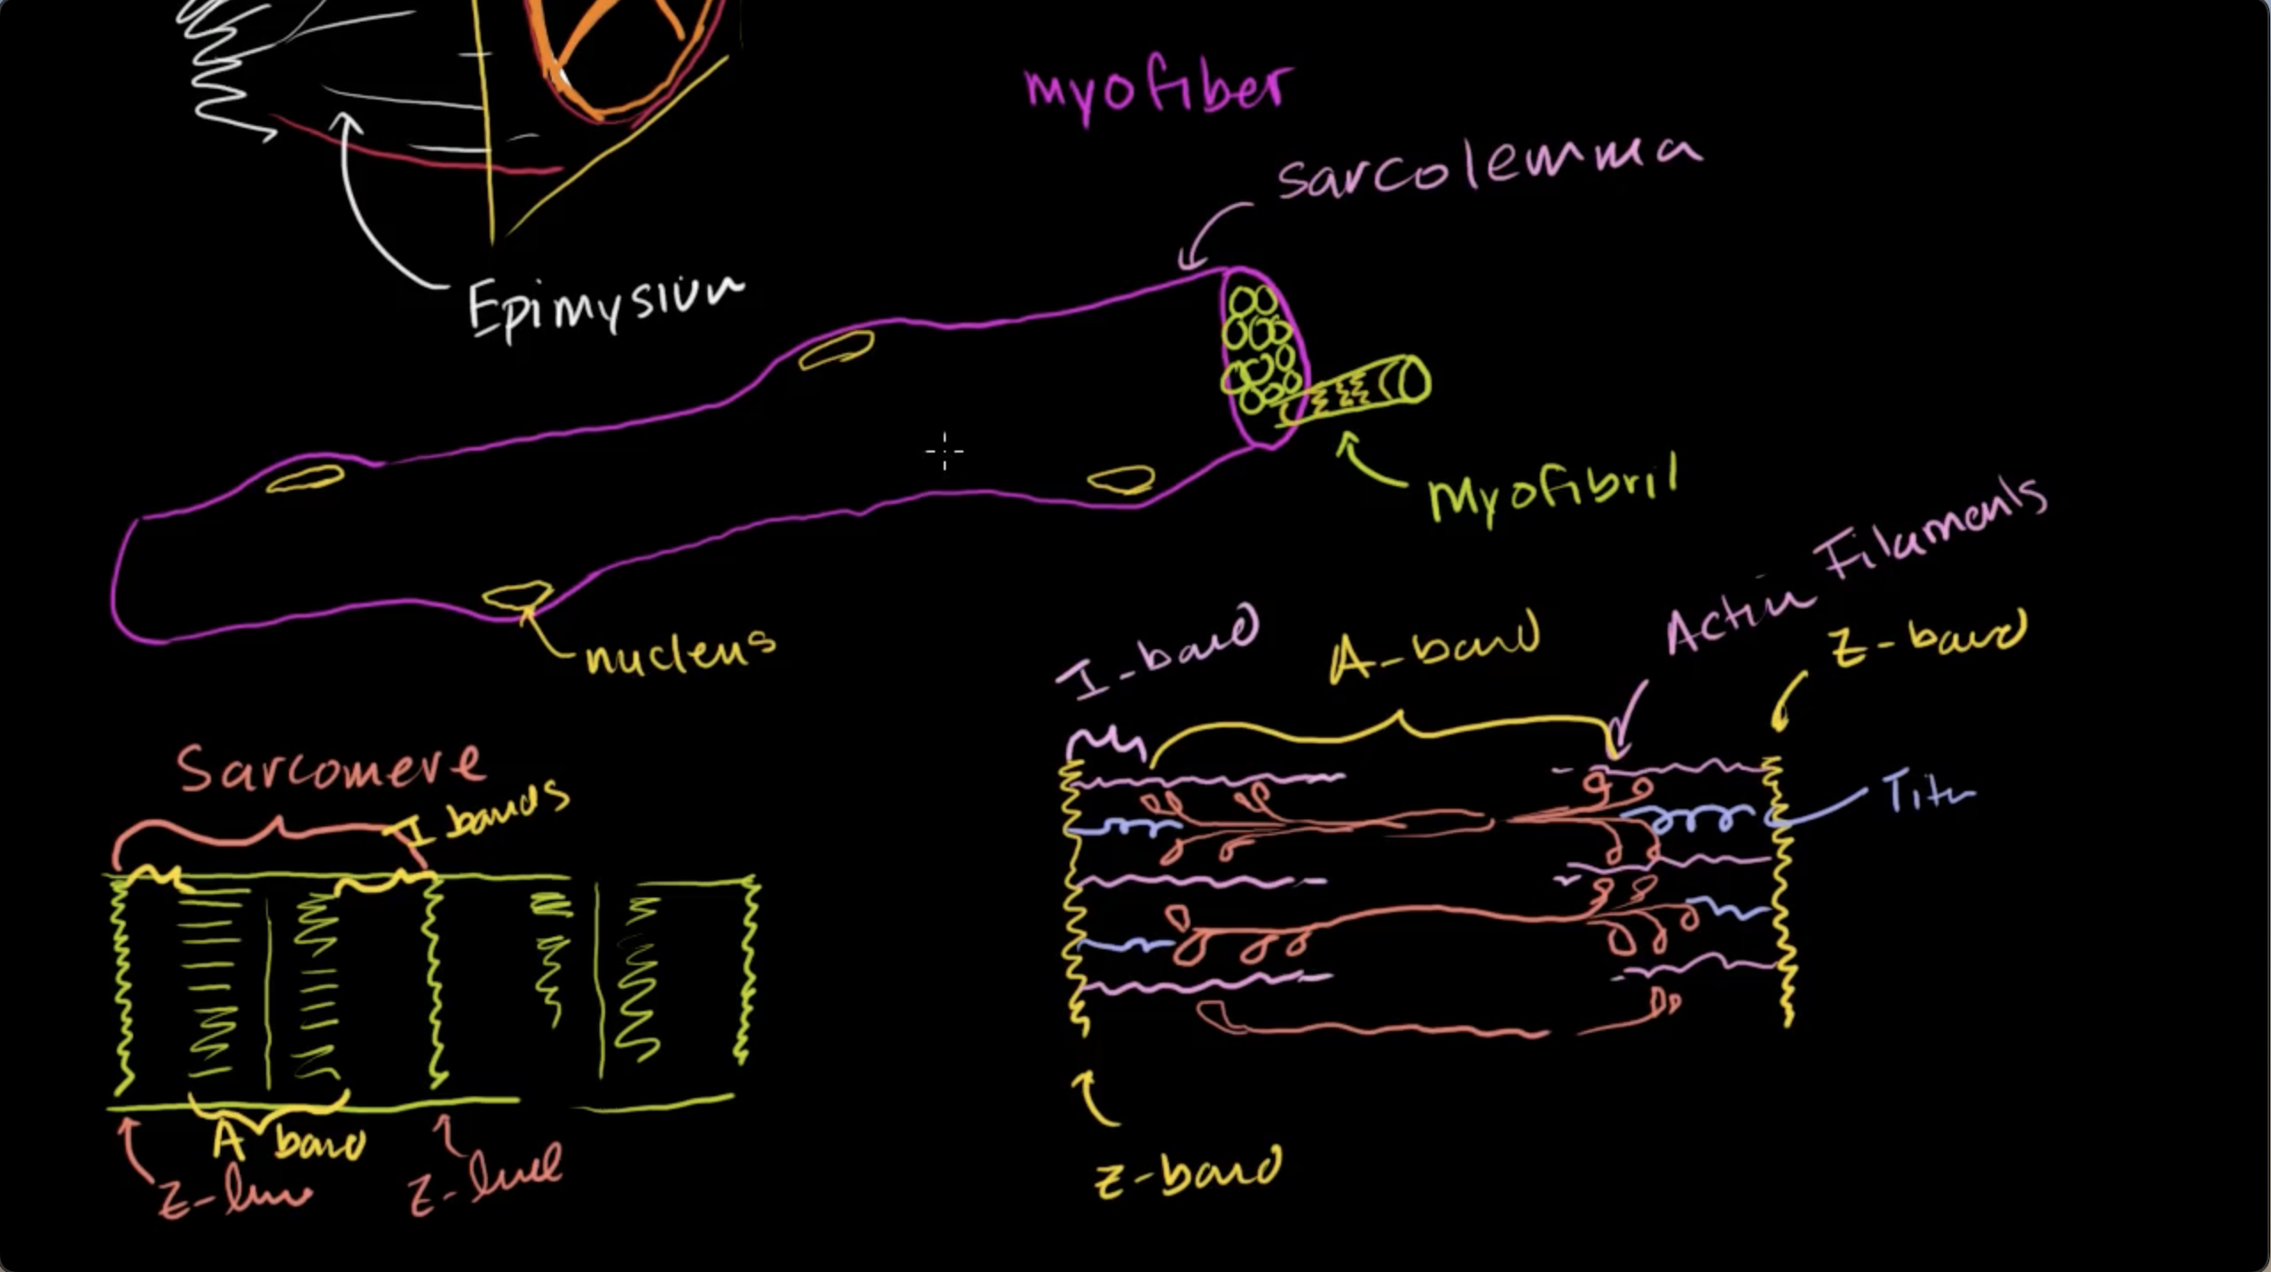

Slide 15
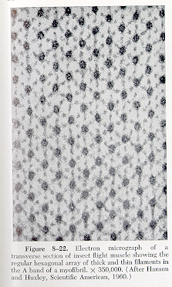
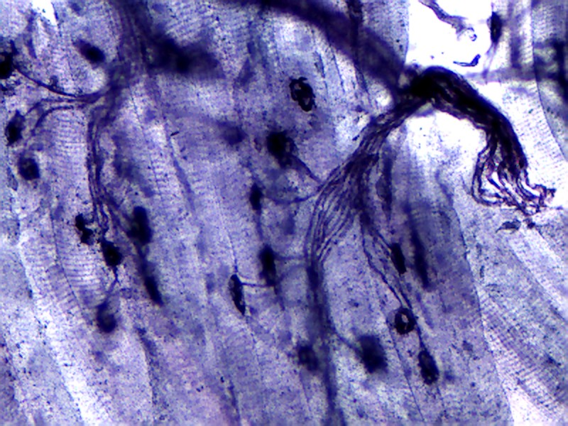
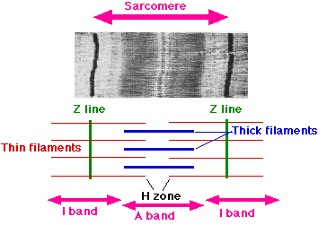
Muscle Structure and the Neuromuscular Junction

Slide 16
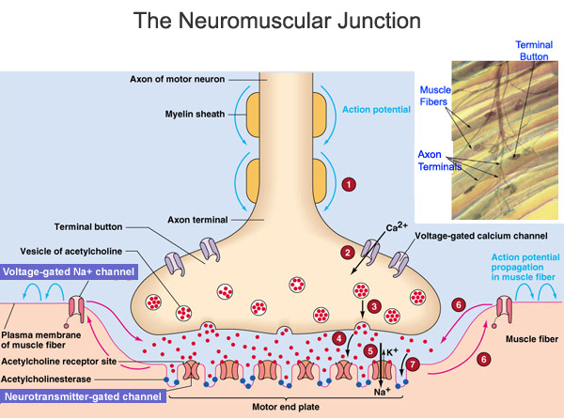
The Neuromuscular Junction

Slide 17
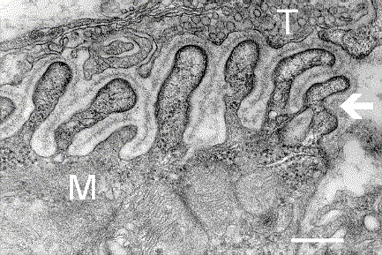
The Neuromuscular Junction
Axon Terminal
Muscle
Increased surface area → signal amplification between the neuron and muscle

Slide 18
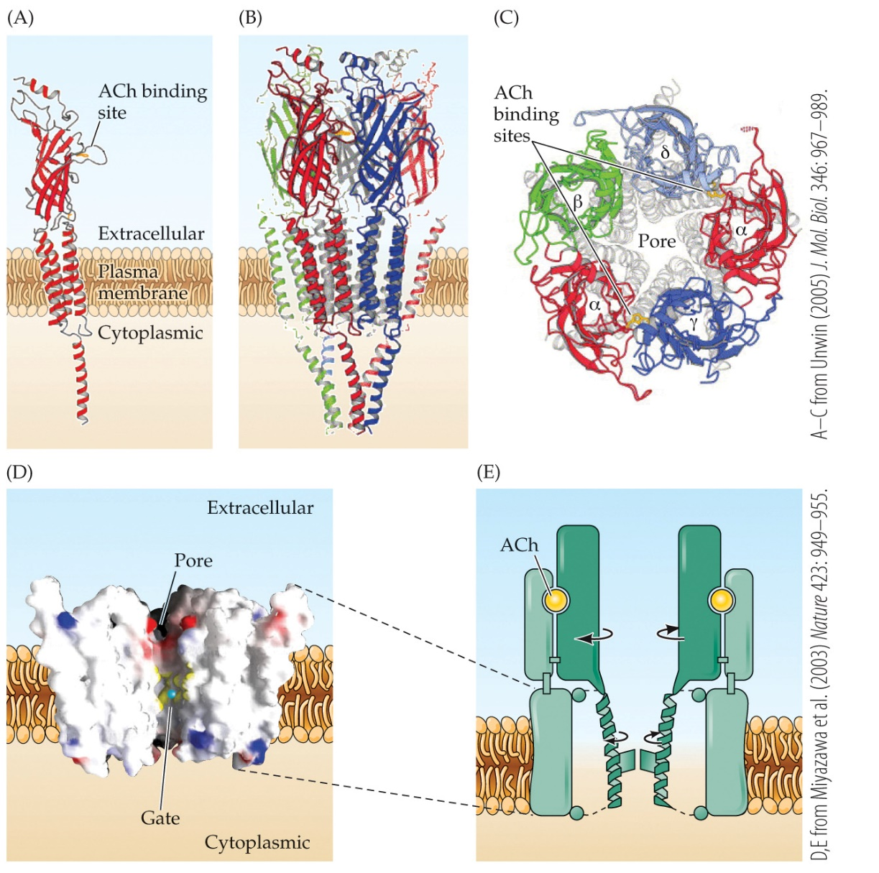
Acetylcholine Receptors
Acetylcholine is the primary neurotransmitter for motor neuron-muscle communication
Nicotinic AChR:
Ligand-gated
Ionotropic (allow for nonspecific monovalent cation flow)
Excitatory

Slide 19
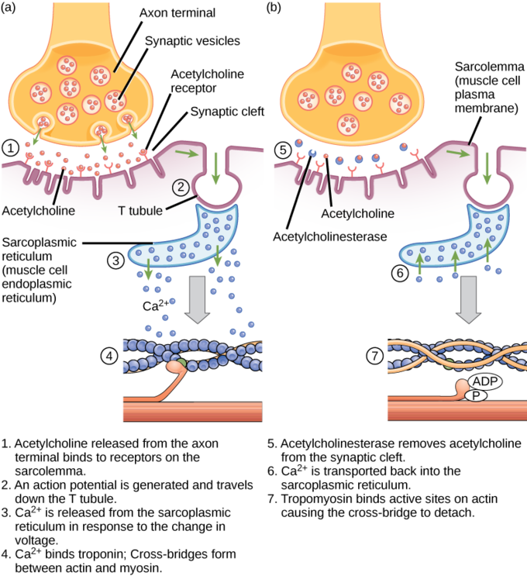
Excitation of Muscle
Contraction
Relaxation

Slide 20
Skeletal Muscle Organization
Mechanism of force production=
Actin-myosin cross bridges
Actin
Myosin
Sarcomere

Slide 21
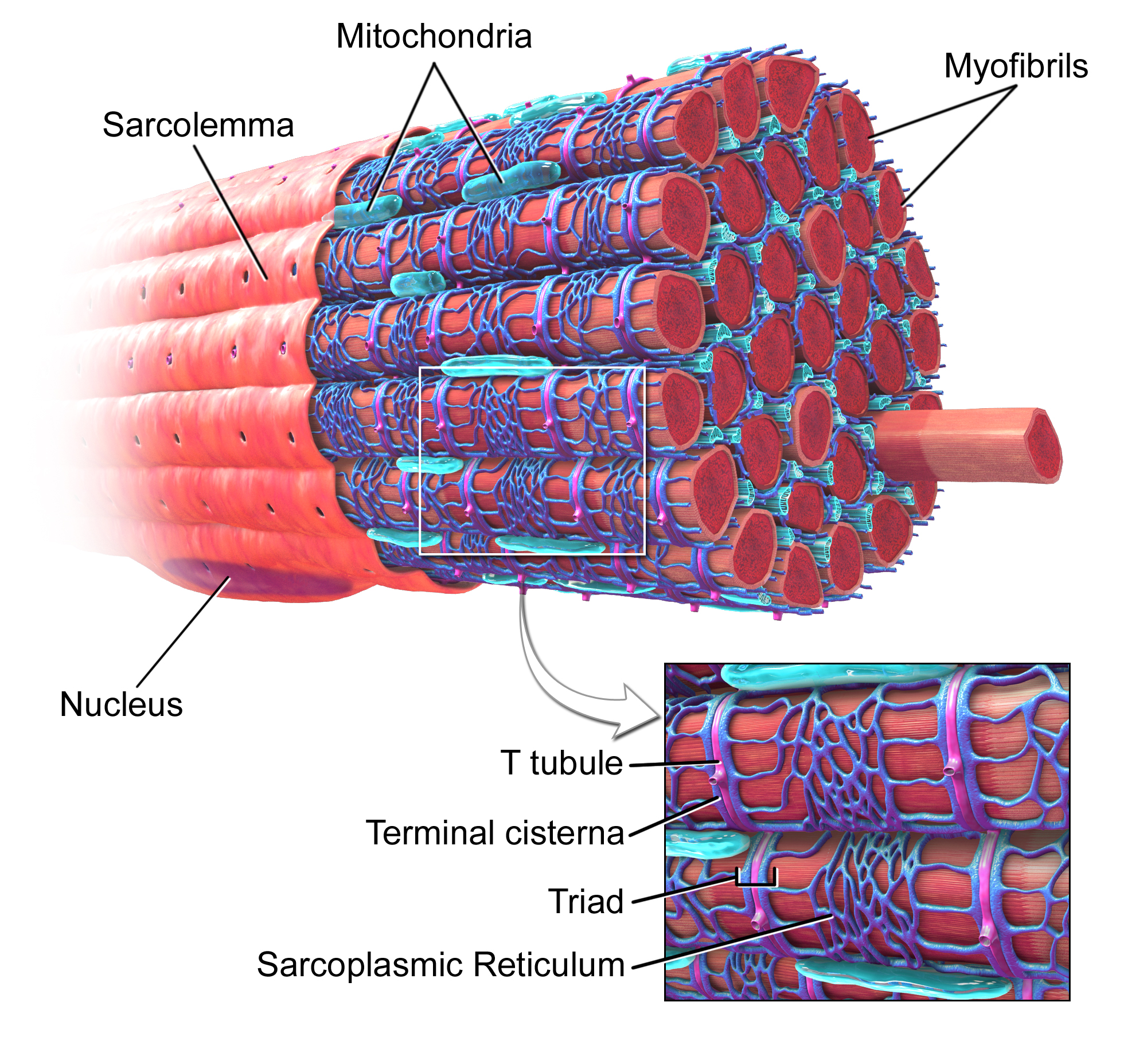

Slide 22
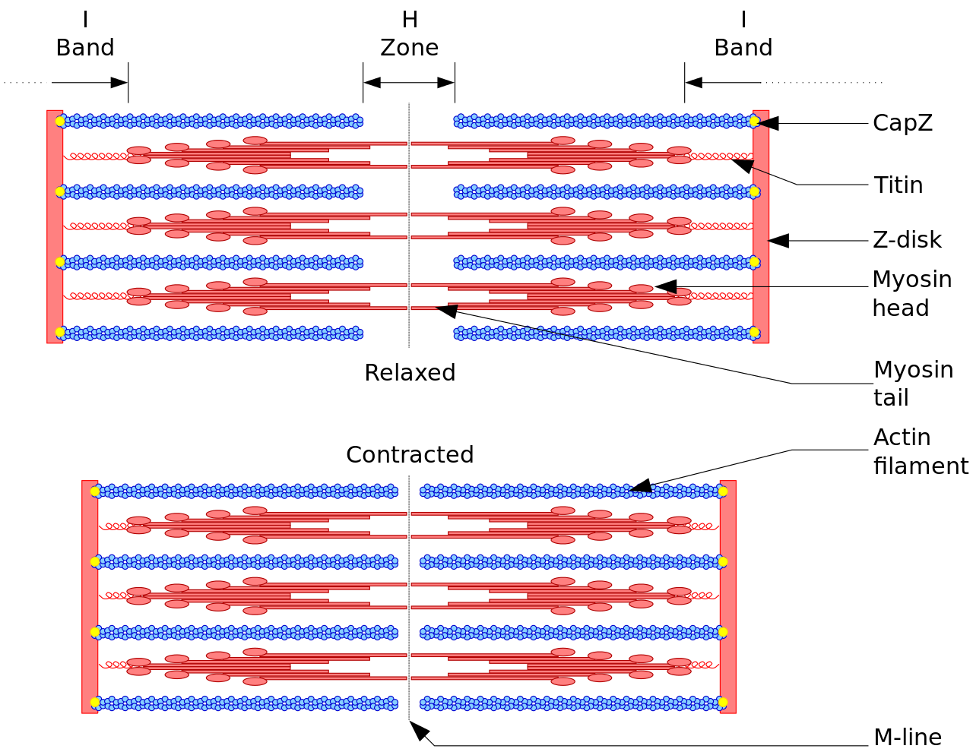
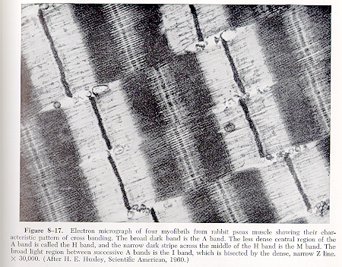
Sarcomeres and Sliding Filament Theory

Slide 23
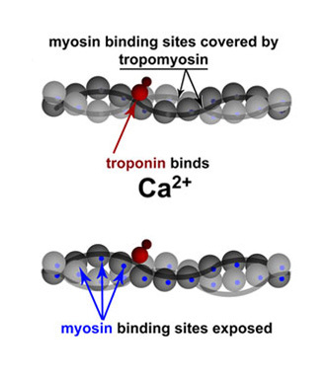
Molecular Model of Sliding Filaments
Calcium influx from the sarcoplasmic reticulum

Slide 24
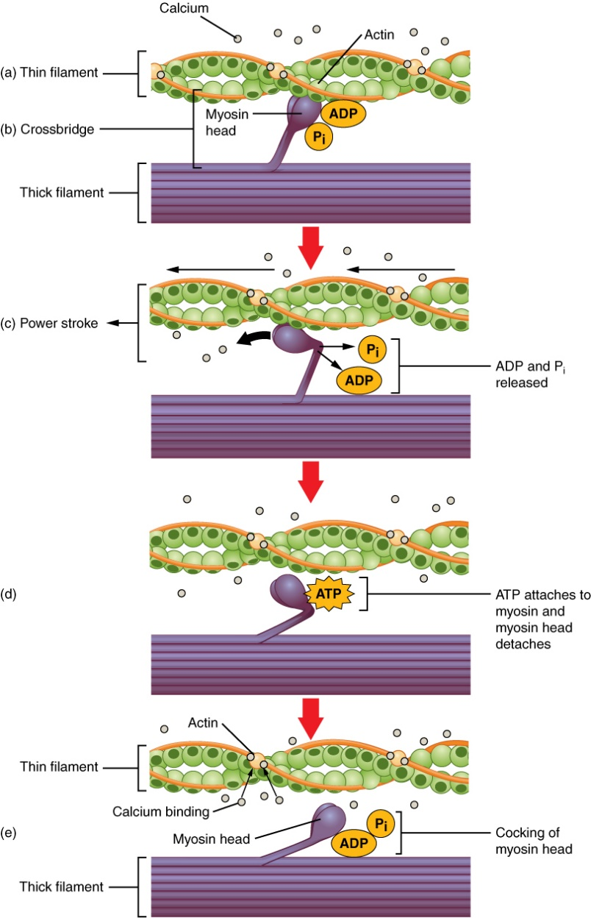
Molecular Model of Sliding Filaments
Myosin binding sites on actin are exposed as Ca²⁺ binds to troponin
The myosin head binds to actin to form a cross-bridge
POWER STROKE: the myosin head bends and expels the ADP and P_{i}
ATP binds to the myosin head and causes detachment
ATP hydrolyzes into ADP and P_{i} and returns the myosin to its “cocked” position
Cross-bridges can again form and the cycle repeats itself
Force production
Number of cross-bridges determines the force produced

Slide 25
Sarcomeres and Sliding Filament Theory

Slide 26
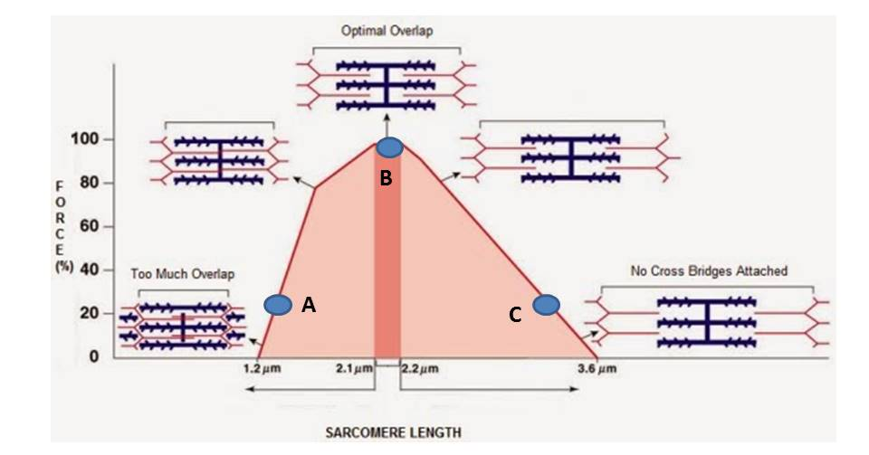
Force Production Based on Sliding Filament Theory
Most important point: number of cross-bridges determines the force!

Slide 27
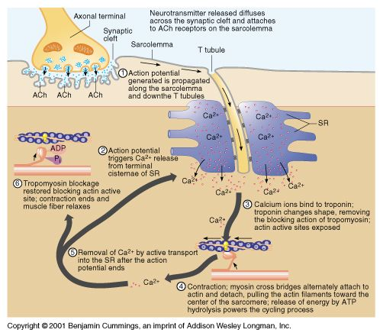
Excitation-Contraction Coupling

Slide 28
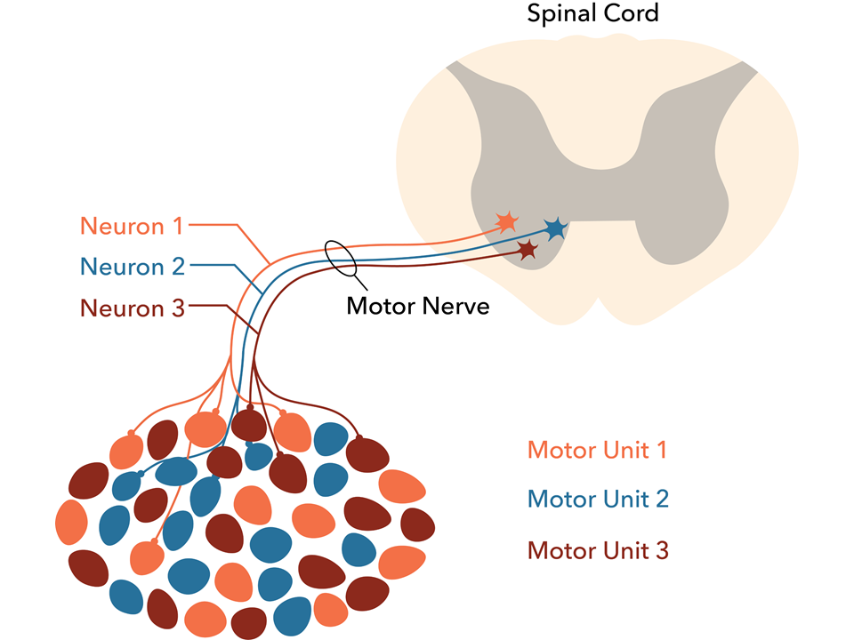
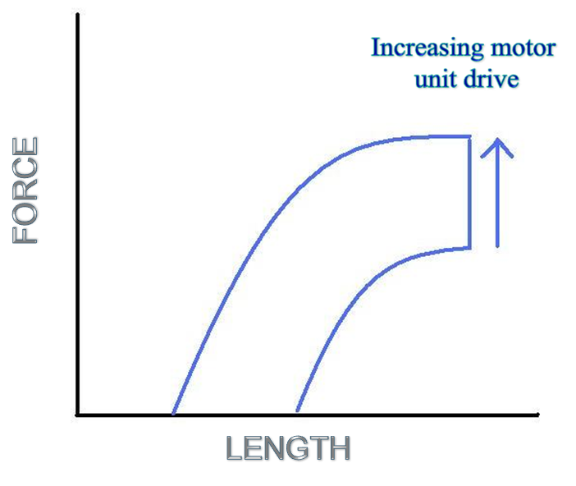
Motor Units
Motor unit: a single motor neuron, its axon, and all of the muscle fibers it innervates
A “functional” unit of muscle contraction

Slide 29
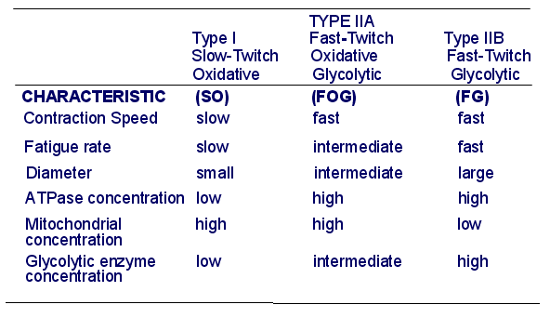
Skeletal Muscle Fiber Types
walk
run
sprint

Slide 30
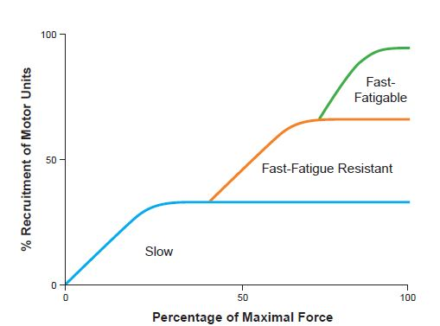
Size Principle of Motor Unit Recruitment

Slide 31
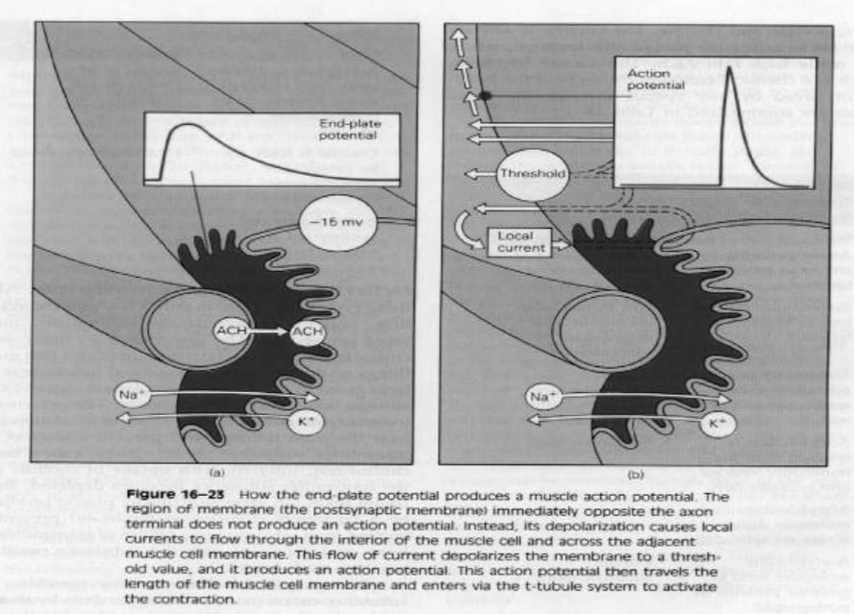
Muscle Signals

Slide 32
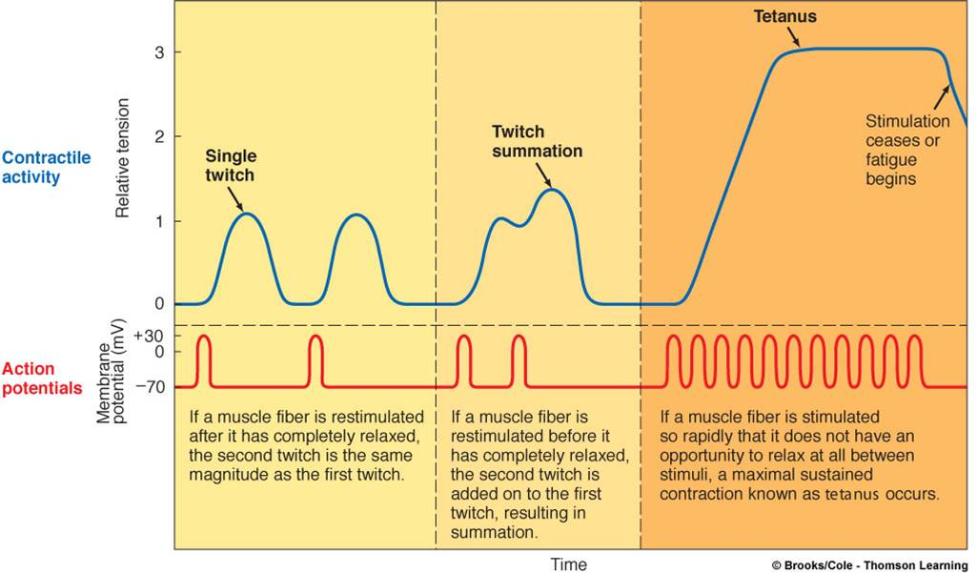
Muscle Signals

Slide 33
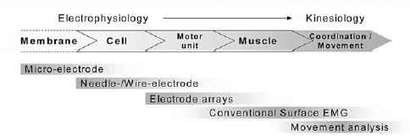
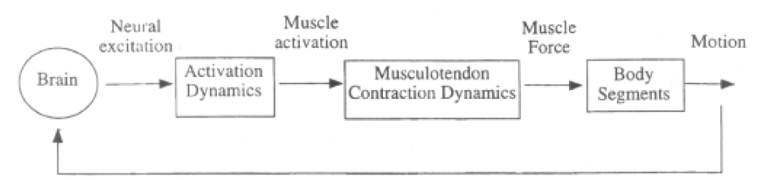
Muscle Components and Recording Techniques
Patch Clamp

Slide 34
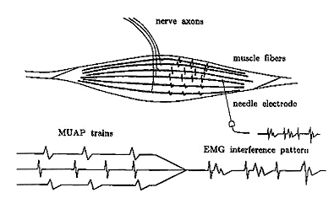
EMG Measurements and Types of Electrodes
Electromyogram: the sum of all motor unit action potentials transmitted along the muscle fibers at that point in time
www.backtohealthonline.com/emg.gif

Slide 35
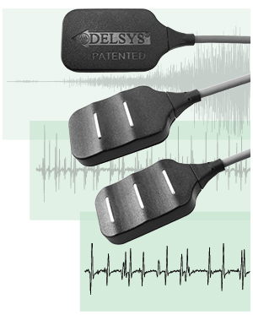
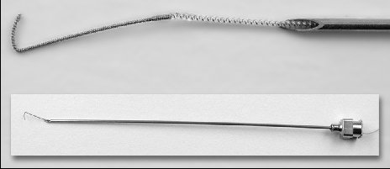
EMG Measurements and Types of Electrodes
Surface Electrode
Time force relationship of EMG signals
Kinesiological/Neurophysiological/ Psychophysiological studies of surface muscles
Interfacing an individual with an external electromechanical device
More reproducible results than the intramuscular electrode
Intramuscular Electrode
Kinesiological/Neurophysiological studies of deep muscles
Limited studies of motor unit properties

Slide 36
Excitation-Contraction Coupling

